Slide 1
Business, Marketing, Entrepreneurship, Digital Marketing, and Econ Mrs. Schafer

Slide 2
Economics
Production Possibilities Curve – a lesson in efficiency
Scarcity
Tradeoffs
Opportunity Cost Calculations
Efficiency
Constant Opportunity Cost
Capital vs Consumer Goods
Circular Flow Model

Slide 3
What is the Production Possibilities Curve?
A production possibilities curve (or frontier) is a model that shows alternative ways that an economy can use its scarce resources.
This model graphically demonstrates scarcity, trade-offs, opportunity costs, and efficiency.
4 Key Assumptions
Only two goods can be produced
Full employment of resources
Fixed Resources
Fixed Technology
Copyright
ACDC Leadership 2020

Slide 4
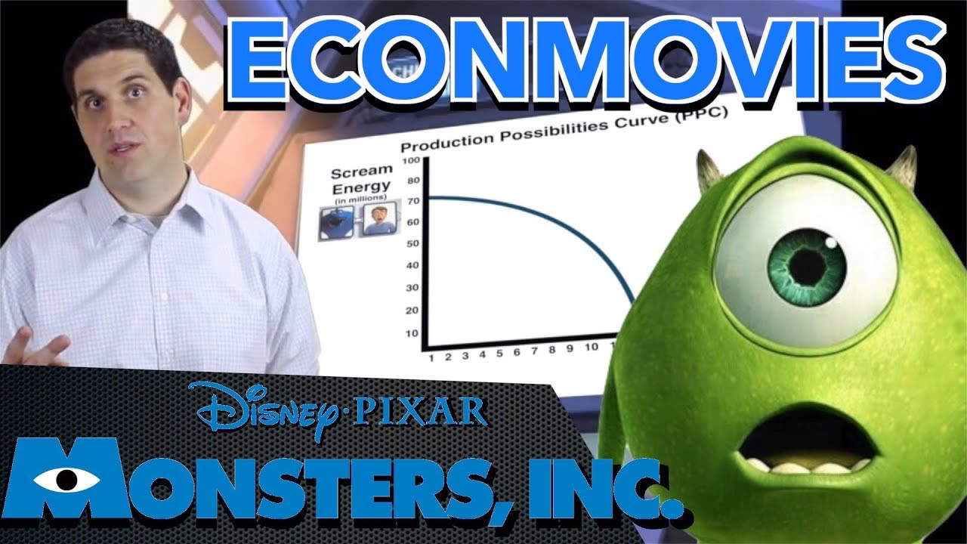

Econmovies
Monsters Inc.
4
Notes:
https://www.youtube.com/watch?v=UYlBLw-ShIM

Slide 5
Production “Possibilities” Table
A
B
C
D
E
f
Bikes
14
12
9
5
0
0
Computers
0
2
4
6
8
10
Each point represents a specific combination of goods that can be produced given full employment of resources.
NOW GRAPH IT: Put bikes on y-axis and computers on x-axis

Slide 6
Production Possibilities
How does the PPC graphically demonstrate scarcity, trade-offs, opportunity costs, and efficiency?
14
12
10
8
6
4
2
0
Impossible/Unattainable
(given current resources)
A
B
G
C
Bikes
Efficient
D
Inefficient/ Unemployment
E
0 2 4 6 8 10
Computers
Copyright
ACDC Leadership 2020
6
Notes:
Scarcity- Any point outside the curve is impossible
Trade-offs- You can’t produce more computers without giving up some bikes
Opportunity Cost- The opportunity cost of moving from combination A to B is 2 bikes
Efficicency- Any point on the curve is efficient (you are using all your resources to the fullest)

Slide 7
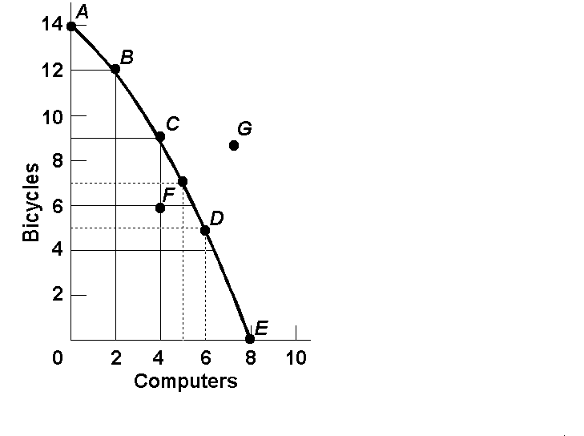
Opportunity Cost
Example:
1. The opportunity cost of moving from a to b is…
2.The opportunity cost of moving from b to d is…
3.The opportunity cost of moving from d to b is…
4.The opportunity cost of moving from f to c is…
5.What can you say about point G?
7
Notes:
Print these as a worksheet for people to do individually in class

Slide 8
Opportunity Cost (Answers)
Example:
1. The opportunity cost of moving from a to b is…
2 Bikes
2.The opportunity cost of moving from b to d is…
7 Bikes
3.The opportunity cost of moving from d to b is…
4 Computer
4.The opportunity cost of moving from f to c is…
0 Computers
5.What can you say about point G?
Unattainable
8

Slide 9

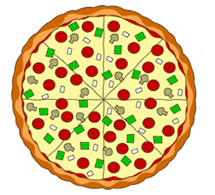
Production Possibilities
A B C D E
CALZONES 4 3 2 1 0
PIZZA 0 1 2 3 4
List the Opportunity Cost of moving from a-b, b-c, c-d, and d-e.
Constant Opportunity Cost- Resources are easily adaptable for producing either good.
Result is a straight line PPC (not common).
9

Slide 10
Production Possibilities
PIZZA 20 19 16 10 0
ROBOTS 0 1 2 3 4
List the Opportunity Cost of moving from a-b, b-c, c-d, and d-e.
Law of Increasing Opportunity Cost-
As you produce more of any good, the opportunity cost (forgone production of another good) will increase.
Why? Resources are NOT easily adaptable to producing both goods.
Result is a bowed out (Concave) PPC.

Slide 11
Opportunity Cost
This PPC shows the increasing opportunity cost of producing fish in terms of coconuts lost.
Quantity
of coconuts
Producing the first
20 fish . . .
…requires giving up only 5 coconuts
35
30
But producing
20 more fish . . .
A
25
20
The concave or bowed-out shape of the PPC reflects an increasing opportunity cost.
…requires giving up
25 coconuts.
15
10
5
PPC
0
10
20
30
40
50
Quantity of fish

Slide 12
Shifting the Production Possibilities Curve
12

Slide 13
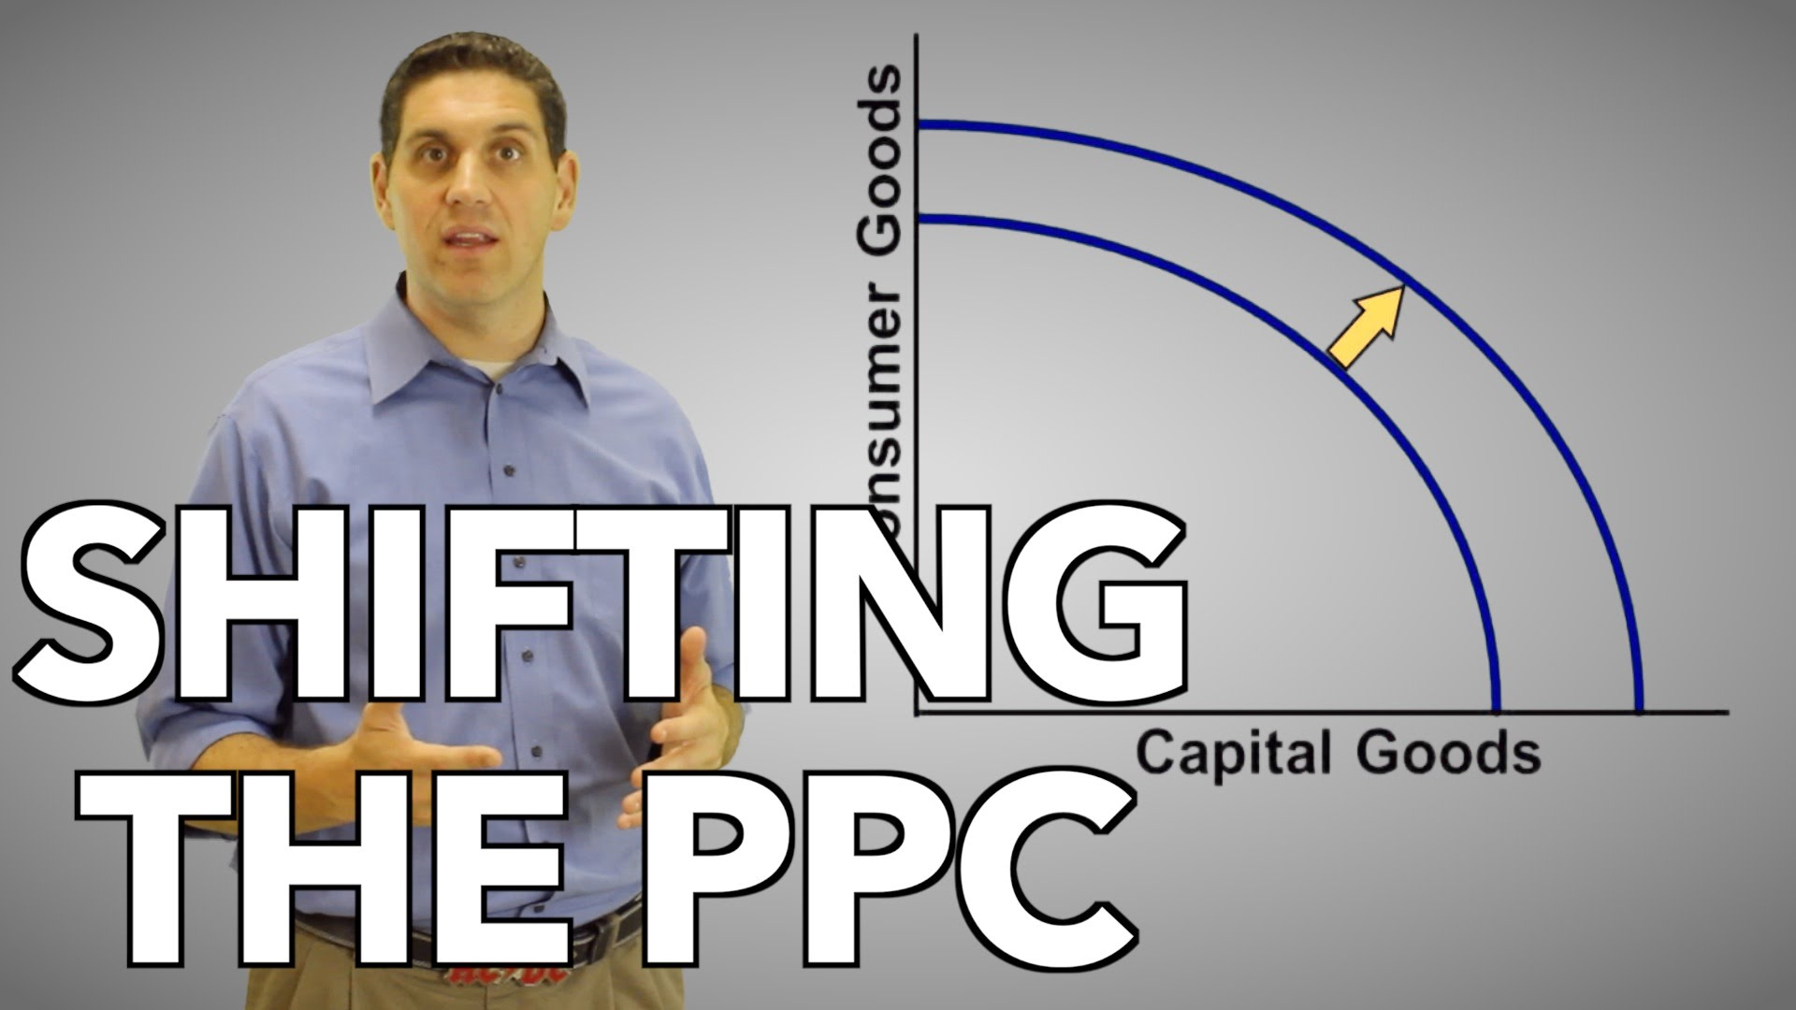
Notes:
https://www.youtube.com/watch?v=FwPiWz1a1Tw&t=16s

Slide 14
Production Possibilities
4 Key Assumptions Revisited
Only two goods can be produced
Full employment of resources
Fixed Resources (4 Factors)
Fixed Technology
What if there is a change?
3 Shifters of the PPC
1. Change in resource quantity or quality
2. Change in Technology
3. Change in Trade (allows more consumption)
14

Slide 15
Production Possibilities
What happens if there is an increase in population?
Computers
Pizzas
15

Slide 16
Production Possibilities
What happens if there is an increase in population?
Computers
Pizzas
16

Slide 17
Production Possibilities
What if there is a technology improvement in pizza ovens?
Computers
Pizzas
17

Slide 18
Production Possibilities
What if there is a technology improvement in pizza ovens?
Computers
Pizzas
18

Slide 19
Consumer vs. Capital Goods
Consumer Goods: Goods and Services used by consumers that are made by Capital Goods
Capital Goods: Goods used to make consumer goods
If you have an increase in Capital goods, you will have an increase in Consumer goods
Notes:
Capital goods are man-made products used by a business to produce consumer or other capital goods. Consumer goods are products used by consumers. Capital goods include items like buildings, machinery, and tools. Examples of consumer goods include food, appliances, clothing, and automobiles.

Slide 20
Capital Goods and Future Growth
Countries that produce more capital goods will have more growth in the future.
Panama – Favors Consumer Goods
Mexico – Favors Capital Goods
Current
PPC
Future
PPC
Future
PPC
Capital Goods
Capital Goods
Current
PPC
Consumer goods
Consumer goods
Panama
Mexico
20
Notes:
Capital goods are man-made products used by a business to produce consumer or other capital goods. Consumer goods are products used by consumers. Capital goods include items like buildings, machinery, and tools. Examples of consumer goods include food, appliances, clothing, and automobiles.

Slide 21
PPC Practice
Draw a PPC showing changes for each of the following:
Pizza and Computers (3)
1. New computer making technology
2. Decrease in the demand for pizza
3. Mad cow disease kills 85% of cows
Consumer goods and Capital Goods (4)
4. Destruction of power plants leads to severe electricity shortage
5. Faster computer hardware
6. Many workers unemployed
7. Significant increases in education
21
Notes:
Everyone works these out on their own at their desks

Slide 22
Question #1
New computer making technology
A shift only for computers.
Computers
Pizzas
22

Slide 23
Question #2
Decrease in the demand for pizza
The curve doesn’t shift!
A change in demand doesn’t shift the curve.
Computers
Pizzas
23

Slide 24
Question #3
Mad cow disease kills 85% of cows
A shift inward only for Pizza.
Computers
Pizzas
24

Slide 25
Question #4
Destruction of power plants
Decrease in resources = decrease production possibilities for both.
Capital Goods (Guns)
Consumer Goods (Butter)
25

Slide 26
Question #5
Faster computer hardware
Quality of a resource improves = shifting the curve outward.
Capital Goods (Guns)
Consumer Goods (Butter)
26

Slide 27
Question #6
Many workers unemployed
The curve doesn’t shift!
Unemployment is just a point inside the curve.
Capital Goods (Guns)
Consumer Goods (Butter)
27

Slide 28
Question #7
Significant increases in education
The quality of labor is improved. Curve shifts outward.
Capital Goods (Guns)
Consumer Goods (Butter)
28

Slide 29
The Circular Flow Model
The Product Market-
The “place” where goods and services produced by businesses are sold to households.
The Resource (Factor) Market-
The “place” where resources (land, labor, capital, and entrepreneurship) are sold to businesses.
29

Slide 30





Resource Market
DEMAND
SUPPLY
$$$ Income $$$
(Factor payments)
$$$ Costs $$$
Resources
Resources
(Factors of
Production)
$$$
Taxes
Taxes
Subsidies
Transfer Payments
Public Goods
Public Goods
Individuals
Businesses
Government
$$$
Goods and
Services
Goods and
Services
$$$ Revenue $$$
SUPPLY
$$$ Spending $$$
DEMAND
Product Market
30
Notes:
Circular Flow Matrix- How the economy works

Slide 31
Circular Flow Model Vocab
Private Sector- Part of the economy that is run by individuals and businesses.
Public Sector- Part of the economy that is controlled by the government.
Factor Payments- Payment for the factors of production, namely: rent, wages, interest, and profit.
Transfer Payments- When the government redistributes income (ex: welfare, social security).
Subsidies- Government payments to businesses.
31

Slide 32
Circular Flow Model Review
Do individuals supply or demand?
2. Do business supply or demand?
3. Who demands in the product market?
4. Who supplies in the product market?
32
Notes:
The Product Market-
The “place” where goods and services produced by businesses are sold to households.

Slide 33
Circular Flow Model Review
Do individuals supply or demand?
2. Do business supply or demand?
3. Who demands in the product market?
4. Who supplies in the product market?
Both, they demand products and supply resources
Both, they supply products and demand resources
Individuals and the government
Businesses
33
Notes:
The Product Market-
The “place” where goods and services produced by businesses are sold to households.

